Slide 1


Machine Learning & Data Science - Wellington
May 2nd, 2019
Practical Active Learning for Image Classification
David Knox, Principal, Data Science

Slide 2


Contents
Introduction
The problems with gathering data
What is Active Learning?
How can Active Learning help us?
What are the components of Active Learning?
Toy Examples:
Active Learning applied to the cifar10 dataset
Why didn’t that work?
Active Learning on a sparse 1-class dataset (1 vs all from cifar10)
Real world politician recognition
Examples from the real world
Tooling

Slide 3
Introduction
Supervised Machine Learning requires a lot of data with which to train accurate models.
If you're starting a project with a lot of unlabelled data and no or very little ground truth labelled data and little budget to fund a labour-intensive labelling effort, where do you start?

Slide 4
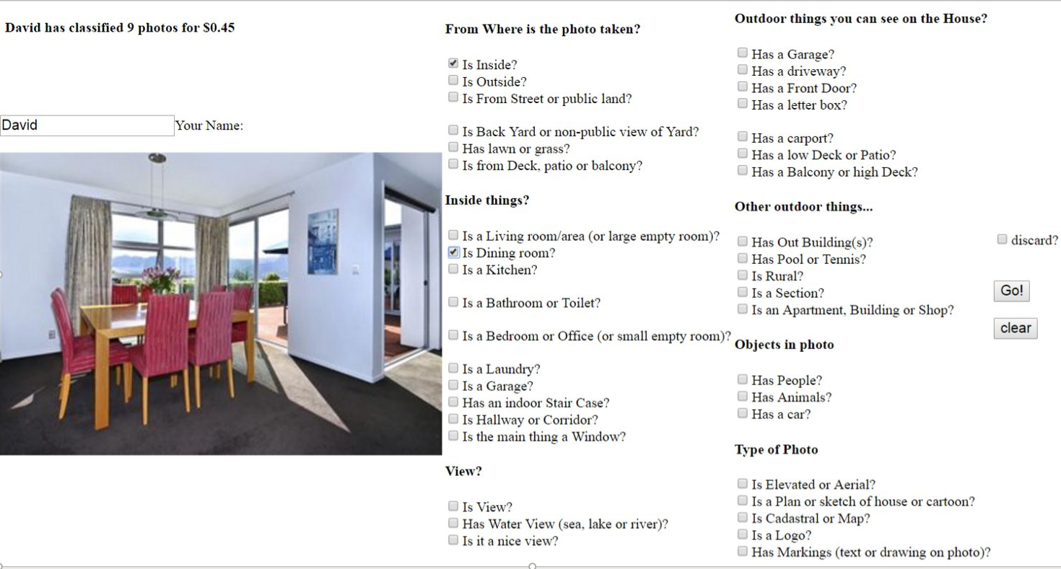
Introduction – Part 2
Also, if you’re faced with gathering data like this…. Surely there’s a better way!

Slide 5
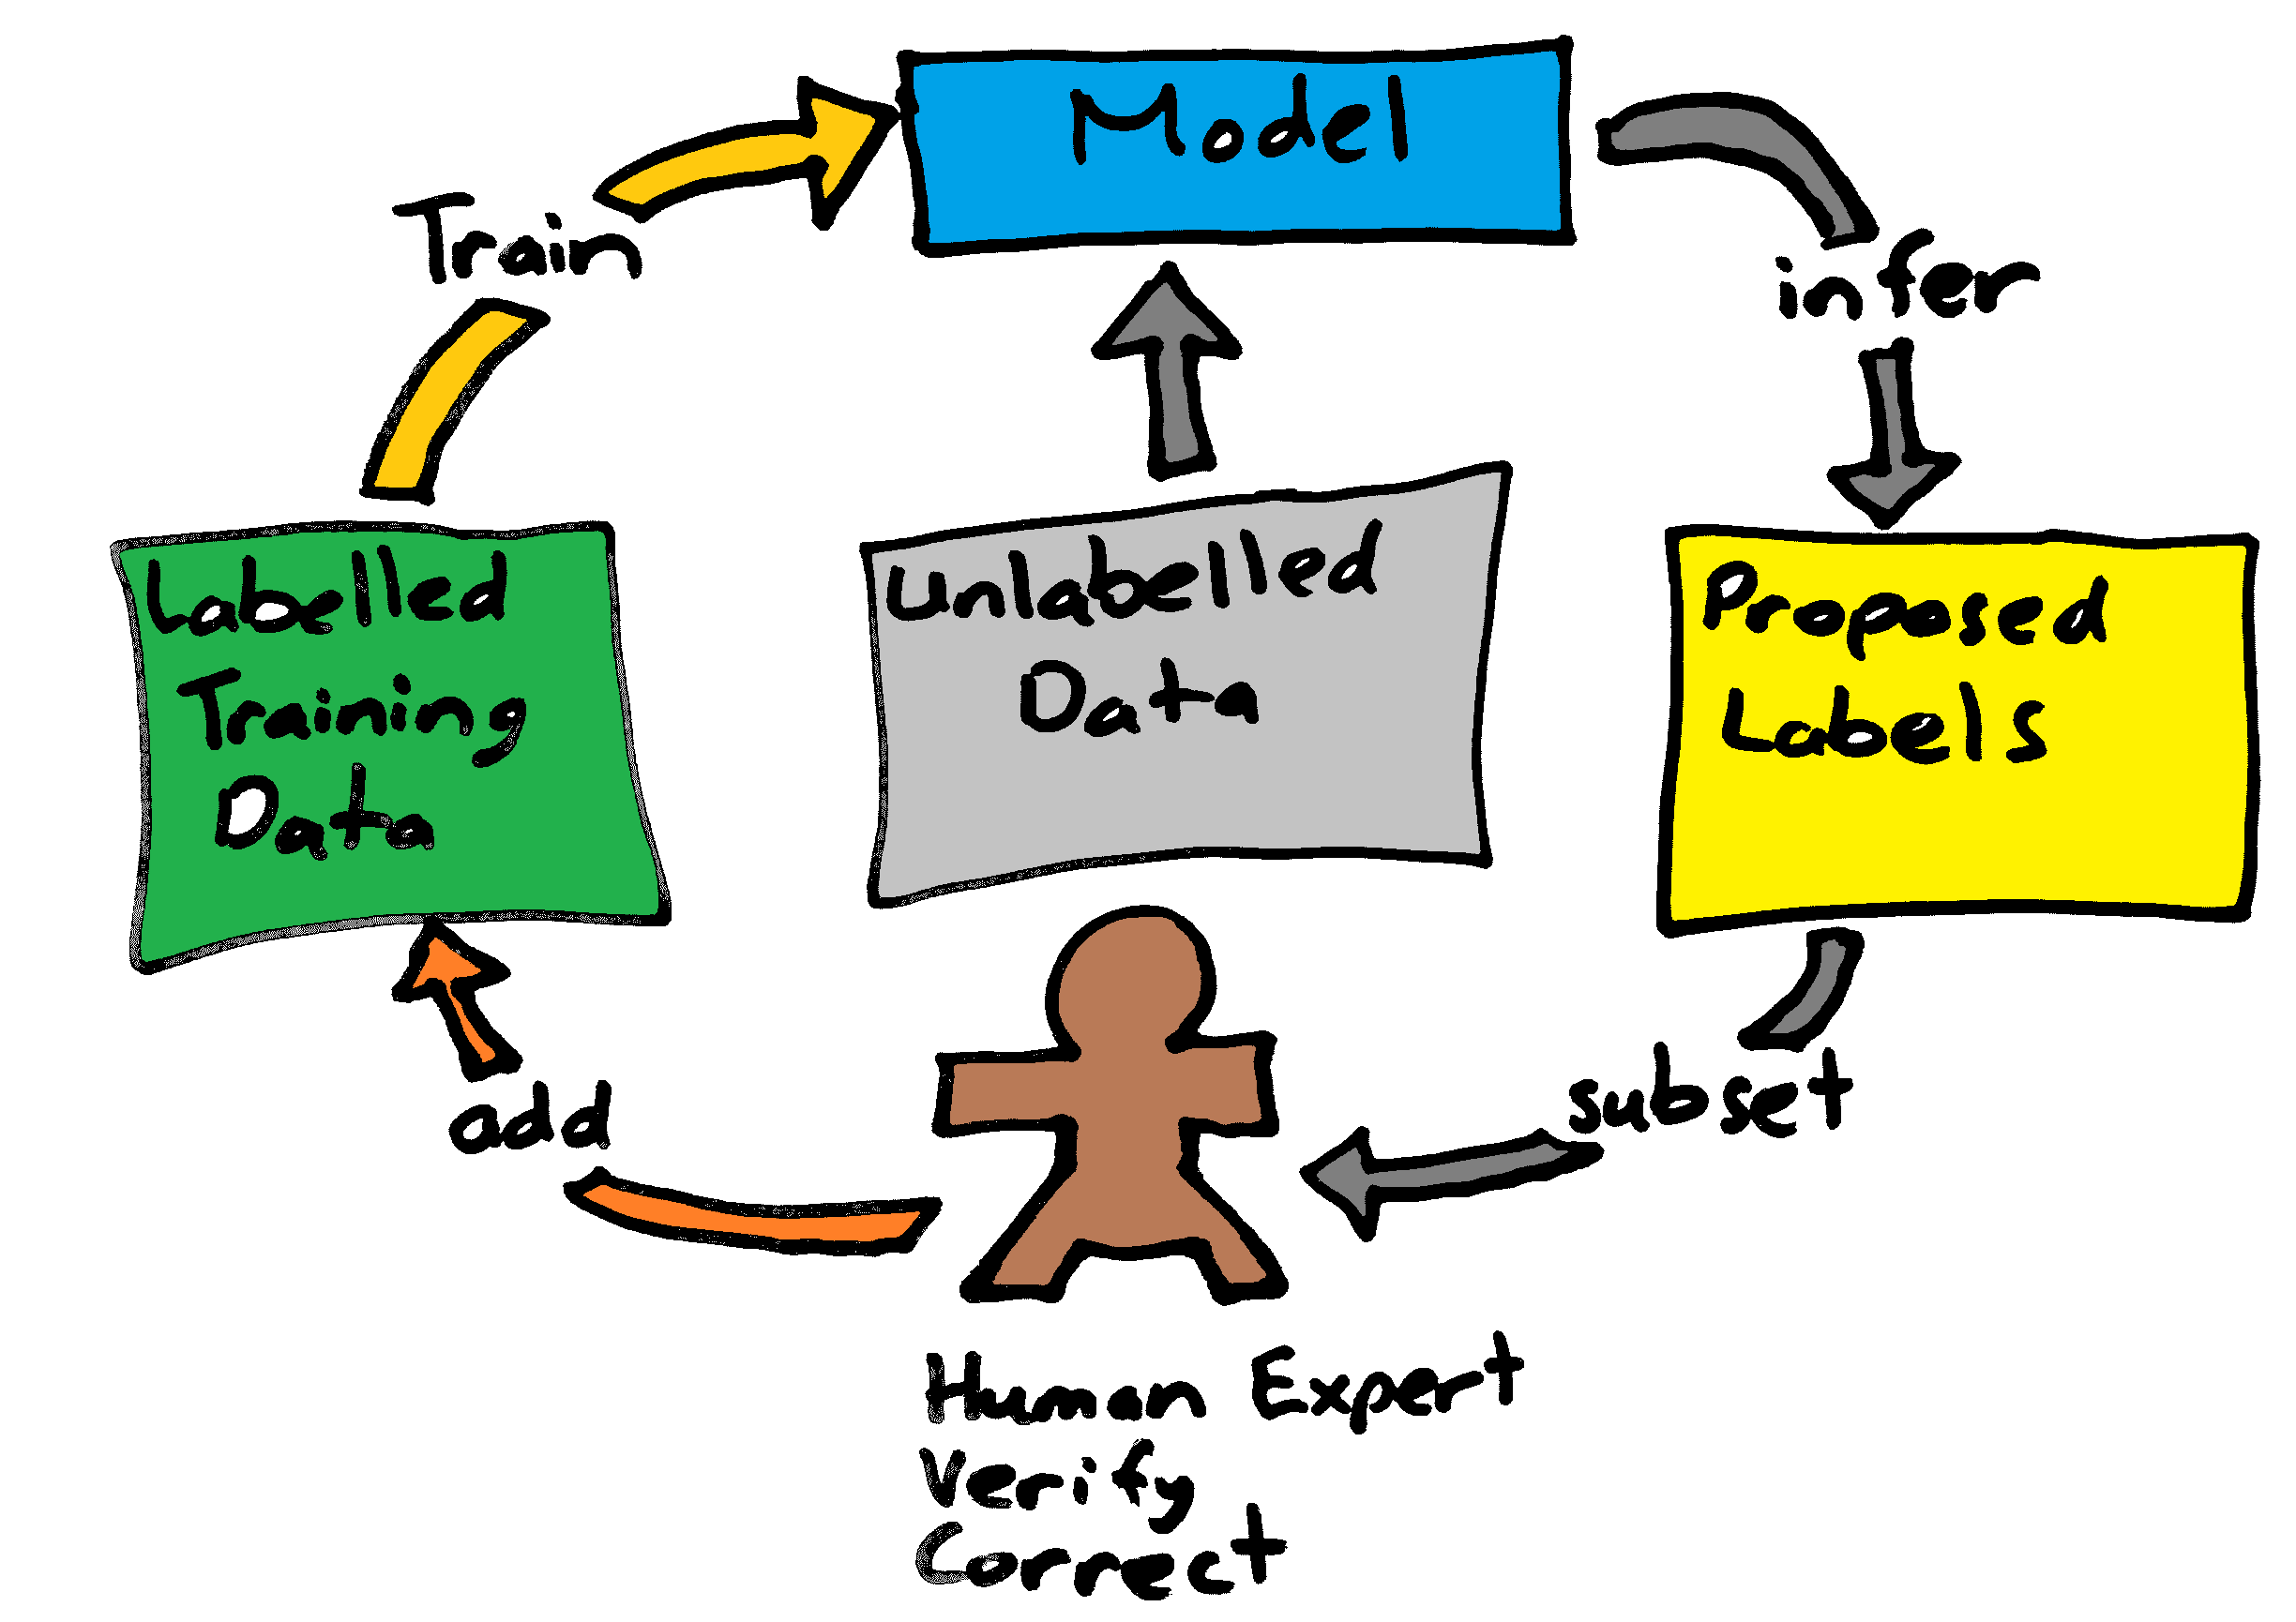
What is Active Learning?
Semi-Supervised Machine Learning
An Iterative process
Small dataset hand labelled
Use this ground-truth to train a weak classifier
Use the weak classifier to tentatively label unlabeled data
Select a subset of this data for expert (human) labelling.
Review and Correct candidates
Repeat…

Slide 6
What is Active Learning good for?
Finding training data.
Your pool of unlabelled data might be large but the items you’re interested in finding might be extremely sparse. How do you find them?
Producing efficient training datasets
You might be able to find a subset of a larger dataset that is good for training accurate models
Speeding up hand-labelling
Ultimately, it’s a labour saving. Reduce the effort hand-labelling.

Slide 7
To do Active Learning, what do you need to know?
SEED data
What existing data is there that you can use to jump-start learning?
If ZERO, how much do you need to manually label?
Sub sampling %
When your weak classifier has proposed labels for some unlabelled data, how much of this data do you send to your human expert to check/label?
20% is a reasonable guess
Sub sampling Method
What metric do you use to rank your proposed labelled data in order to select the best sub-sample for hand-labelling?
How often do you get new samples?
Do you run an Active Learning cycle for every hand-labelled sample (online and synchronous active learning)?
Do you run batches with a few hundred or thousand samples presented each time?
Do you try some compromise between the two with an asynchronous process?

Slide 8
Active Learning Sampling Method
Query Strategies:
Least Confidence
Least Margin
Highest Entropy

Slide 9
Sampling Methods
From the 5 class politicians dataset

Slide 10
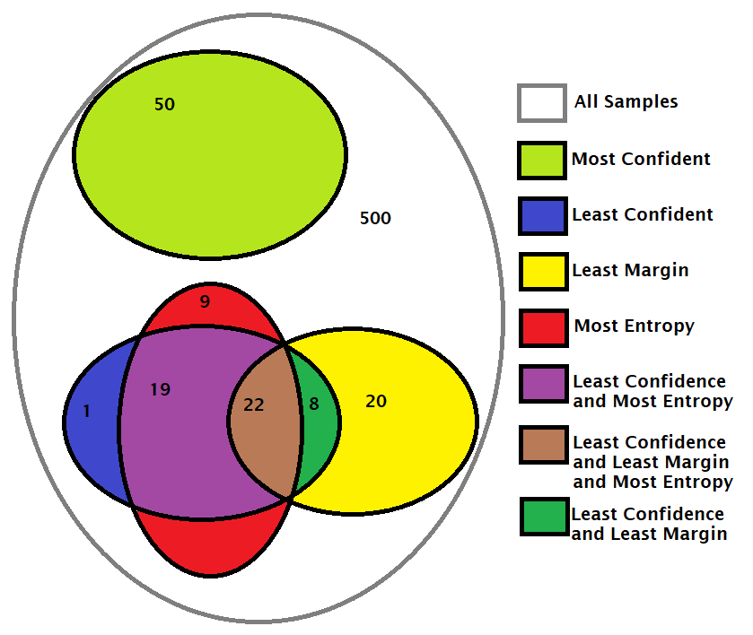
Sampling Methods
From the 5 class politicians dataset
We find that Entropy and Least Confidence
Have a high overlap.
Most Confidence is out on it’s own.

Slide 11
Sampling Methods…
In the 1-class case:
Least Margin and Least Confidence
are proportional
Least Confidence and Entropy
rank samples the same
So, treat these three methods as the same
On 1-class or (positive,negative)
Classifiers.

Slide 12
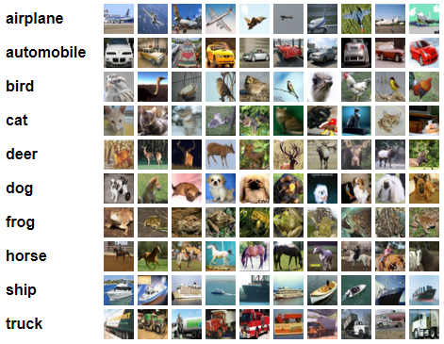
CIFAR 10
Easy to access
10 evenly balanced classes
http://www.cs.toronto.edu/~kriz/cifar.html

Slide 13
How much data do we need to train?
See the script https://github.com/lynker-analytics/ActiveLearning/blob/master/examples/sample_sizes.py
We train a ResNet20 model on cifar10, with various numbers of training samples and with and without data augmentation.
Measure against multi-class accuracy.
Approx linear relation between
log(samples) and accuracy
Between 1000 and 10000 samples.
How does an Active Learning assembled
Subset of training data fare?

Slide 14
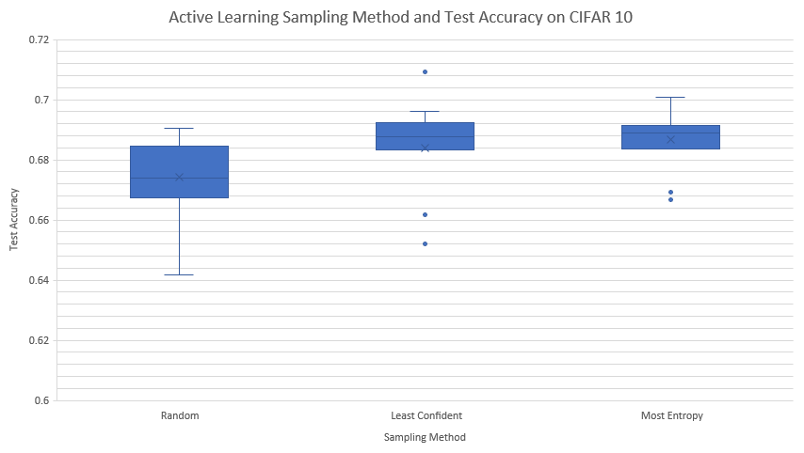
Sampling Methods on CIFAR 10
Seed of 1000 labelled images
3 cycles of Active Learning
20% samples retained of 5000
Total, 4000 training samples.
Fixed 1000 validation samples
10,000 test samples.
15 tests of each case
Active Learning appears to provide
Consistency of result.
Suggestive of improved accuracy
Script here: https://github.com/lynker-analytics/ActiveLearning/tree/master/examples/Active_Sampling_CIFAR10.py

Slide 15
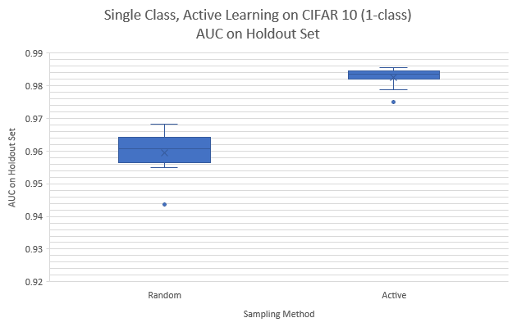
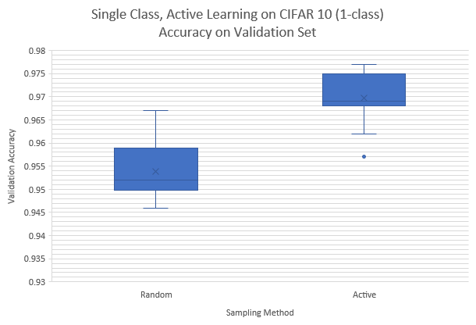
What about single class and sparse data?
Repeat on CIFAR 10 with 1 class versus the rest.
Change test metric to AUC (https://scikit-learn.org/stable/modules/model_evaluation.html#roc-metrics)
5 Active learning rounds, select 20% out of 2500 samples. Seed size of 100 samples. Best results at 2600 training samples.
10 cross validation loops for each case
Note, in single class case, the sampling methods: Least Confidence and Least Margin and Entropy should produce the same selection.

Slide 16
Active Learning on CIFAR 10
On CIFAR 10, Active Learning appears to produce more consistently accurate models with small training sets
It may or may not be more accurate
Why isn’t it better?
Could be implementation
Could be that CIFAR 10 is a well curated dataset with balanced classes
all samples are similarly informative
So, for more consistent results, use Active Learning
For more accurate and consistent results on sparse data, use Active Learning

Slide 17
Active Learning in the Wild

Slide 18
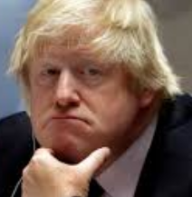


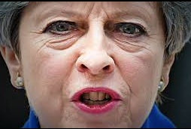

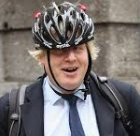
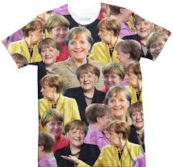
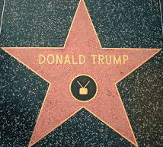


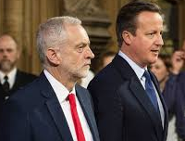

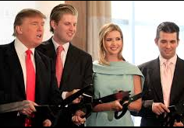
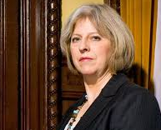

A “Real World” dataset - Politicians
Approximately 3000 images
5 classes (500+ samples per class)
Lots of noise (in the data)
Boris Johnson | Angela Merkel | Donald Trump | Theresa May | Malcolm Turnbull

Slide 19
Active Learning in the Wild
Using the 5 politicians dataset
The human expert interacts with the data via a web page.
The images are stored on the webserver
The labels are stored in a database
Asynchronously,
An inceptionv3 model is finetuned on the already labelled data
The model is then run against the unlabelled data
We sample the output using Most Entropy and select the next
128 samples
These are put into the database as proposed labels for review
This cycle repeats, replacing the for-review samples each loop
Within this inference cycle, we also
test the model against the holdout set
The human reviewer continues to label what is presented to them

Slide 20
Software components
See code here: https://github.com/lynker-analytics/ActiveLearning/tree/master/examples/web/
Human: David
Web: php, with odbc
Database: SQL Server 2017 (Developer Edition) on linux
ML: Tensorflow/Keras
interact with the database using pandas.read_sql
finetune an inceptionv3 model on the human labelled data
keep a consistent separate validation set to use for learning rate and early stopping
validation set based on id of image (id % 3 == 0) so is consistent between re-trainings
run inference against all unlabelled data (only possible for this small dataset)
sample 128 labelled images to based on sampling metric
Improvements:
Use transfer learning to speed up training/inference cycle
Multiple models to make use of all data

Slide 21
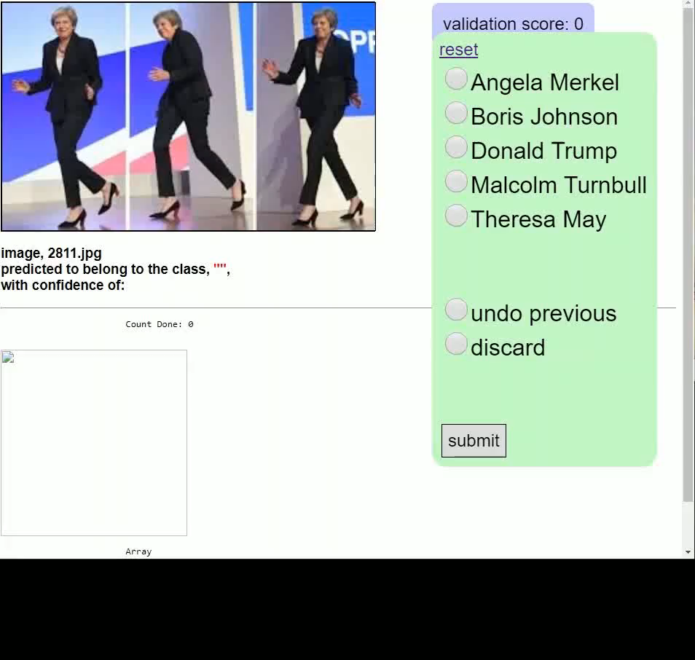
Active Learning in the Wild

Slide 22
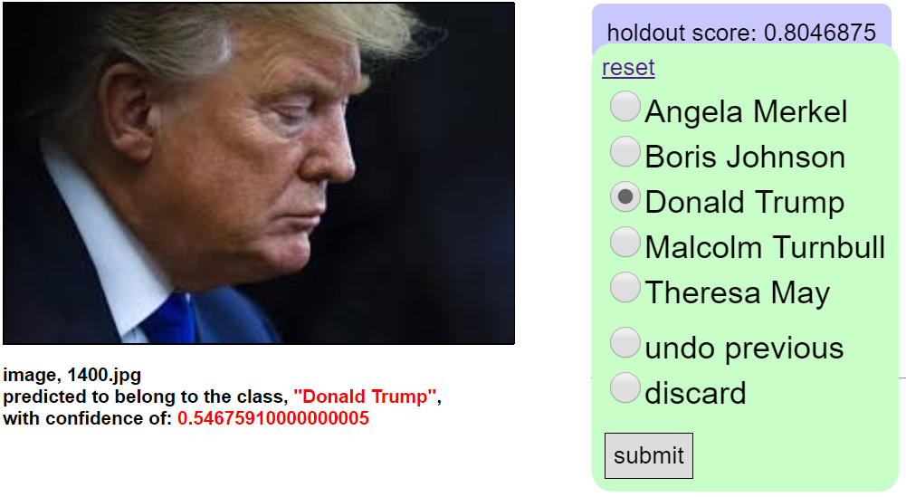
Active Learning Politicians
Entropy sampling brings out noise samples
And confusing samples early on!
Entropy sampling can lead to human burnout!

Slide 23
Active Learning to move from difficult labelling to QA

Slide 24
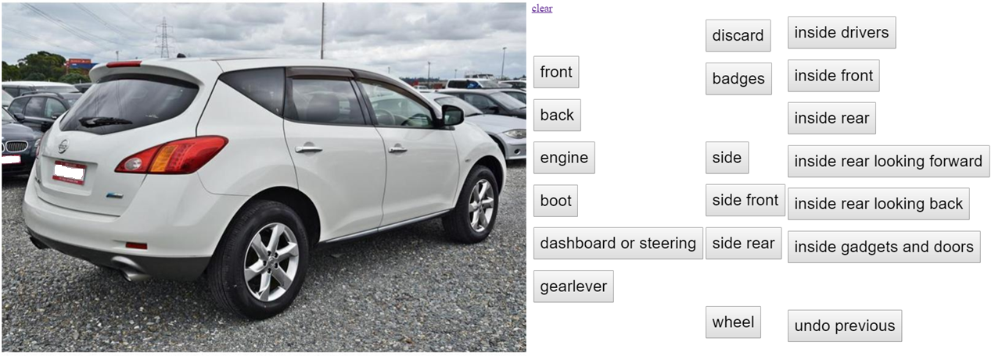
Active Learning: From labelling to QA
Another strong use case for Active Learning is to reduce effort where hand labelling requires time consuming consideration of many classes... and so this...

Slide 25
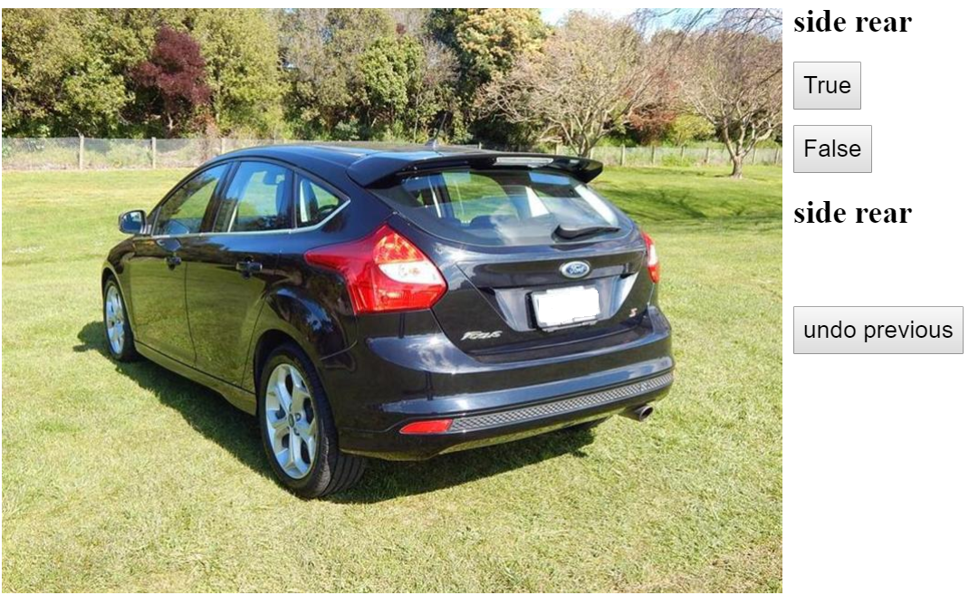
Active Learning: From labelling to QA
Becomes this...

Slide 26
Active Learning applied to extremely Sparse Data

Slide 27
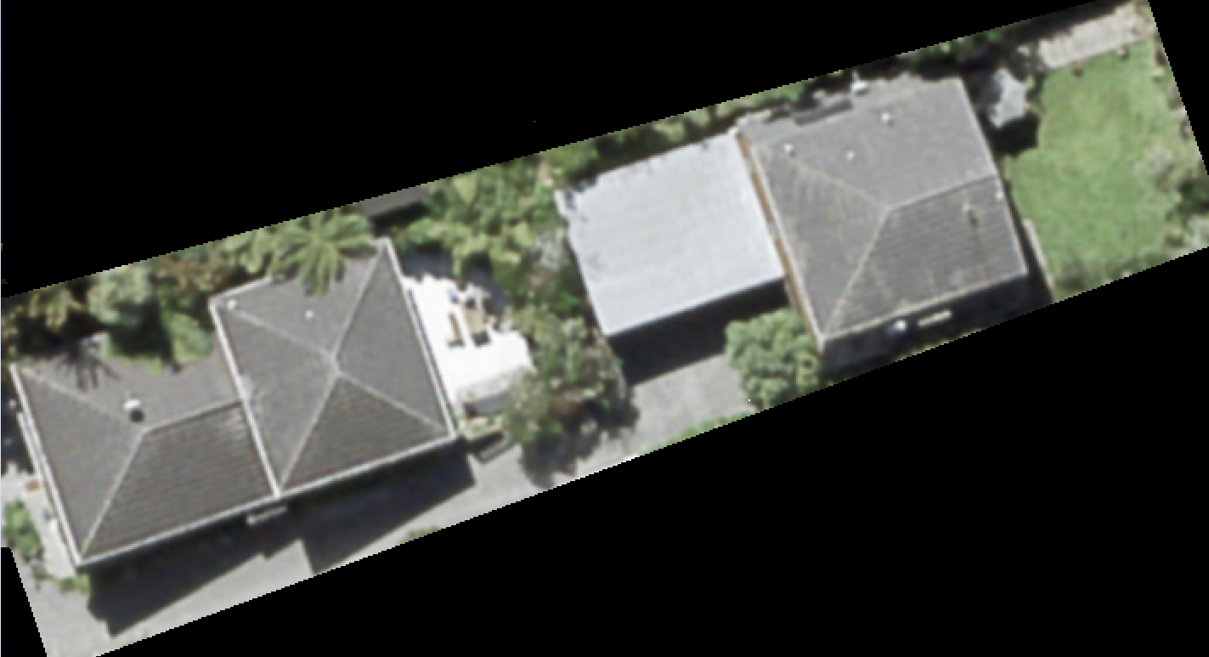
Active Learning: From Sparse Classes to (more) Balanced
Another strong use case for Active Learning is to reduce effort where images of interest are buried in large pools of unlabelled and mostly uninteresting data.
Case: Find residential swimming pools from Aerial Imagery
Unlabelled data:
Aerial view of 1.5 million residential parcels in NZ
Noisy Labels:
Some known pools from text mining property records - noisey and sparse.
About 40k with many false positives (such as spa pools)
About 2-3% of images are expected to show pools

Slide 28
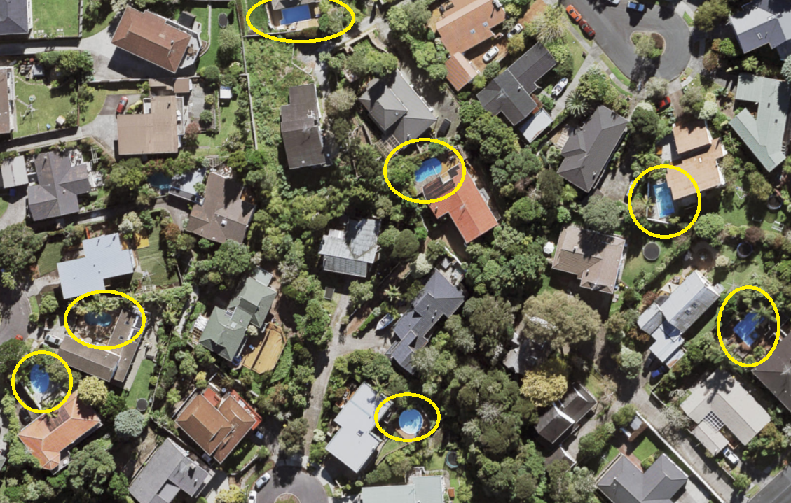
Active Learning: From Sparse Classes to (more) Balanced
Using Active Learning,
Trained weak model on noise-y existing data
Used data to select out noise using least confidence and manual review
This step to speed curating of existing noisy dataset
retrained model
Run model on random 100k sample from unlabelled data
Used “Most Confident” metric to select previously unknown pools and “Least Confident” to select informative samples for retraining, selecting a few thousand samples
repeat steps 2&3 a couple of times:
Result is ~60k pools found with 18k previously unknown and noise removed from previous datasets.

Slide 29
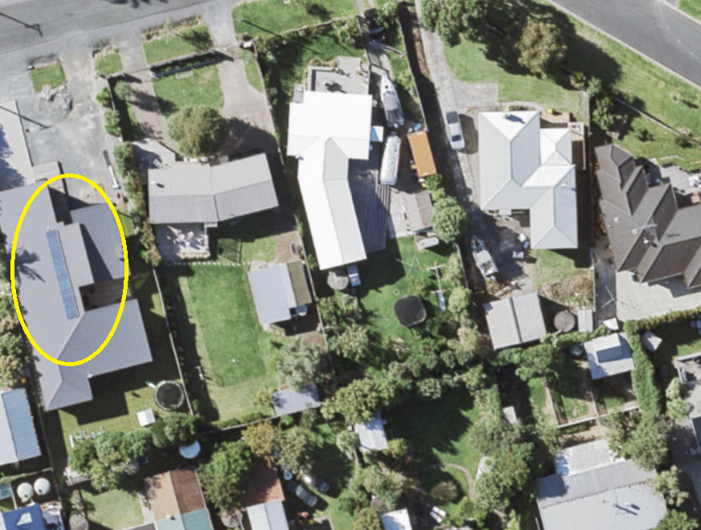
Active Learning: From Sparse Classes to (more) Balanced
A similar case was solar voltaic panels detection.
This was even sparser.
6k found over 1.3 million images
Or approximately ~0.5%
(result depended greatly on the age of imagery. Suspect more than 20k would be found today)

Slide 30
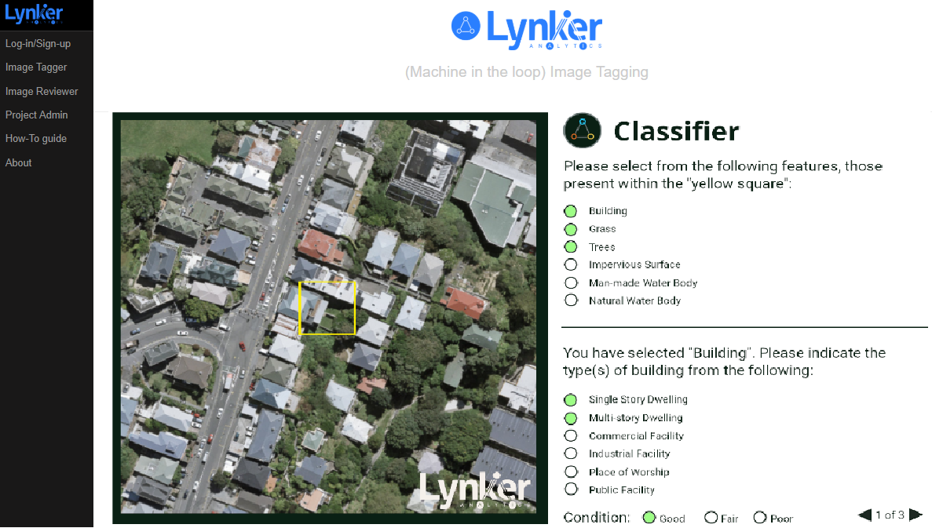
Active Learning Annotation Tool
Active Learning tool for classifying features from imagery services and other geospatial inputs
Integrated with ArcGIS Online (ESRI)

Slide 31
May 2nd, 2019
Practical Active Learning for Image Classification
Thank You!
Machine Learning & Data Science - Wellington
David Knox, Principal, Data Science

